Slide 1
LAB 5

Slide 2
Bubblesort Design

Slide 3
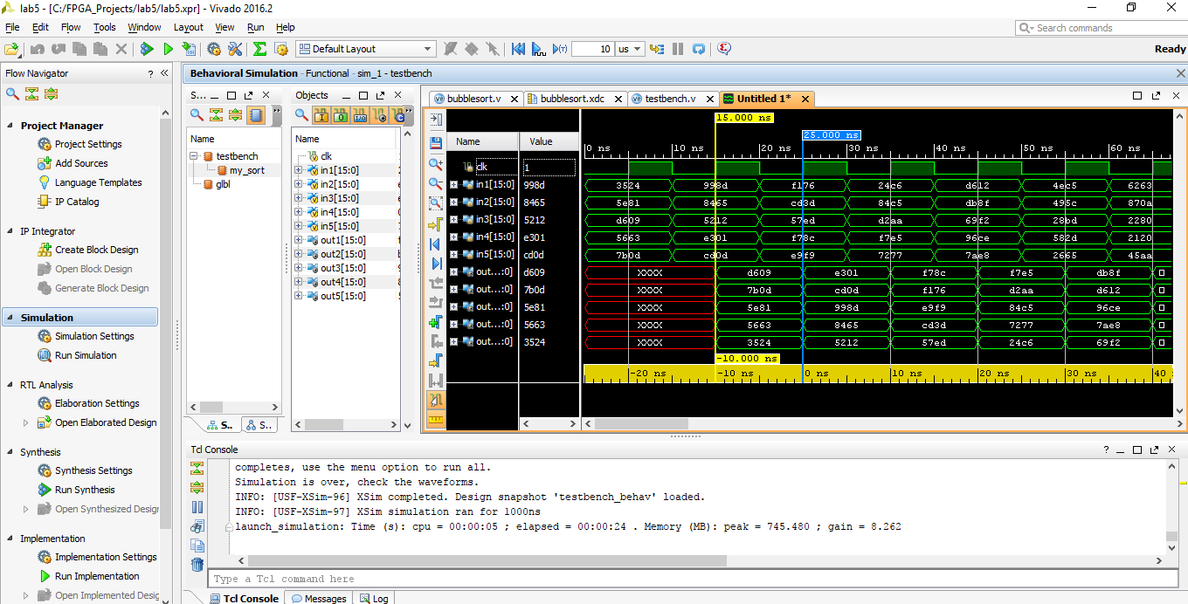

Slide 4
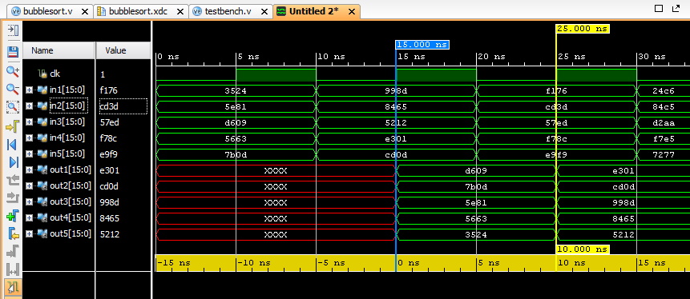
Bubblesort Design
Design latency = 1 clk cycle

Slide 5
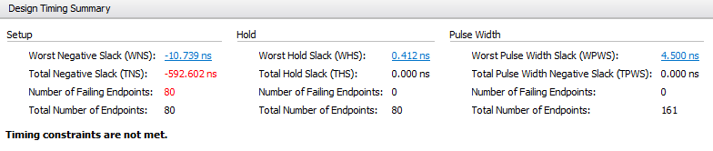
Bubblesort Design Implementation

Slide 6
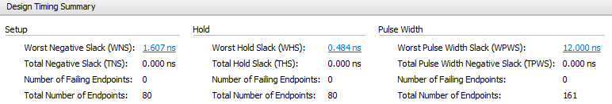
After changing the “clock” timing constraint to: set_property PACKAGE_PIN E3 [get_ports clk] create_clock -period 25.000 -name external_clock [get_ports clk]
(Implementation Successful)

Slide 7
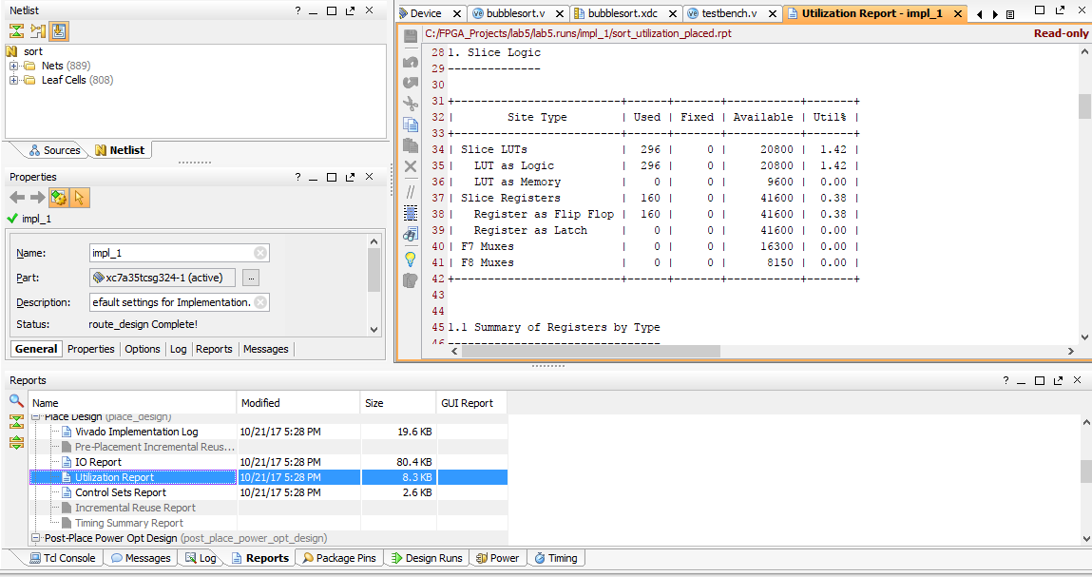
Utilization Report

Slide 8
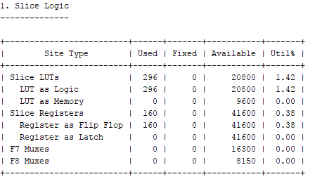
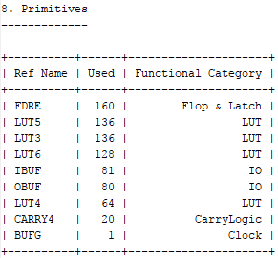

Slide 9
After Constraint Modification
Minimum clk period achieved = 25 ns
Maximum frequency = 40 MHz
Slice LUTs = 296
Slice Registers = 160
Design latency = 1 clk cycle

Slide 10
Odd-Even Design

Slide 11
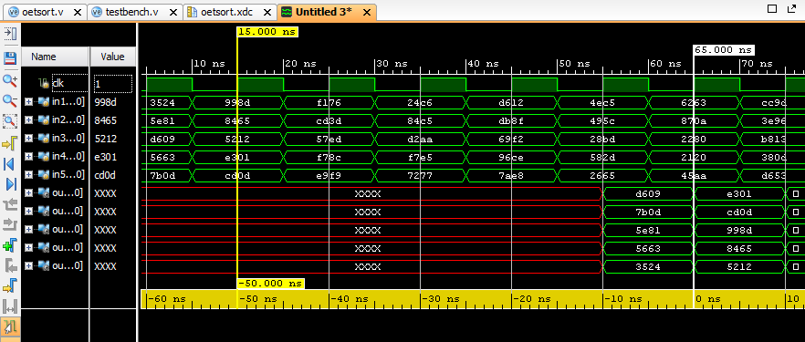
Odd-Even Design
Design latency = 5 clk cycles

Slide 12
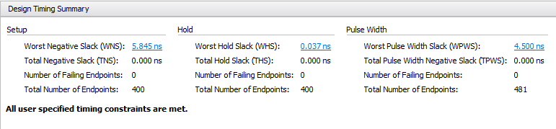
Odd-Even Design Implementation

Slide 13
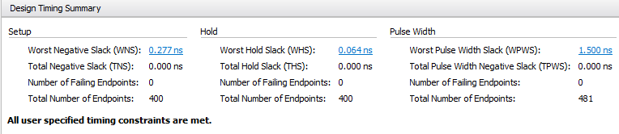
After reducing the clk period in the clock constraint

Slide 14
After Constraint Modification
Minimum clk period achieved = 4 ns
Maximum frequency = 250 MHz
Slice LUTs = 368
Slice Registers = 480
Design latency = 5 clk cycles

Slide 15
After Floorplanning

Slide 16
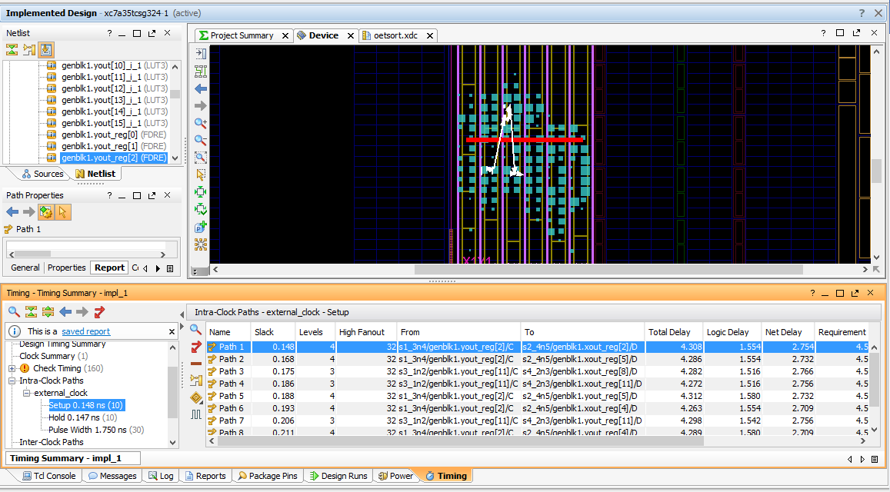
Minimum clk period achieved = 4.5 ns
Maximum frequency = 222.222 MHz
Slice LUTs = 352
Slice Registers = 480
Path of minimum slack

Slide 17
